Slide 1
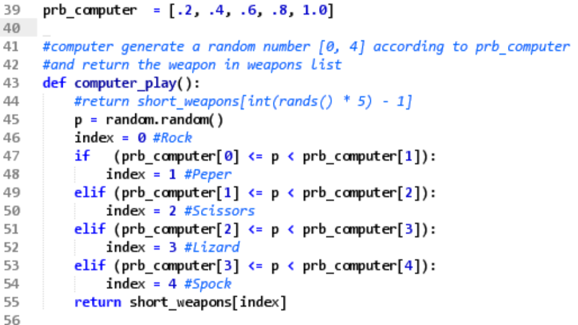
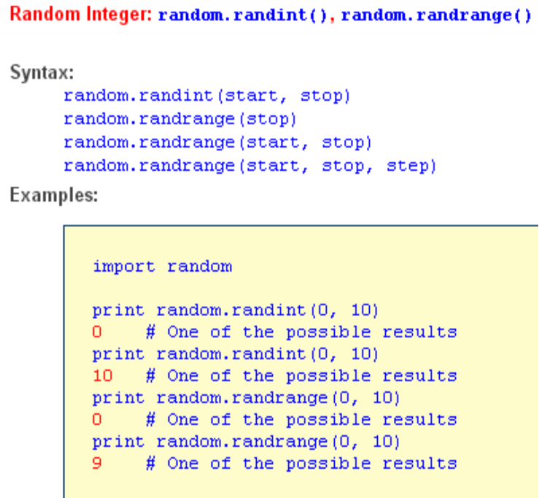
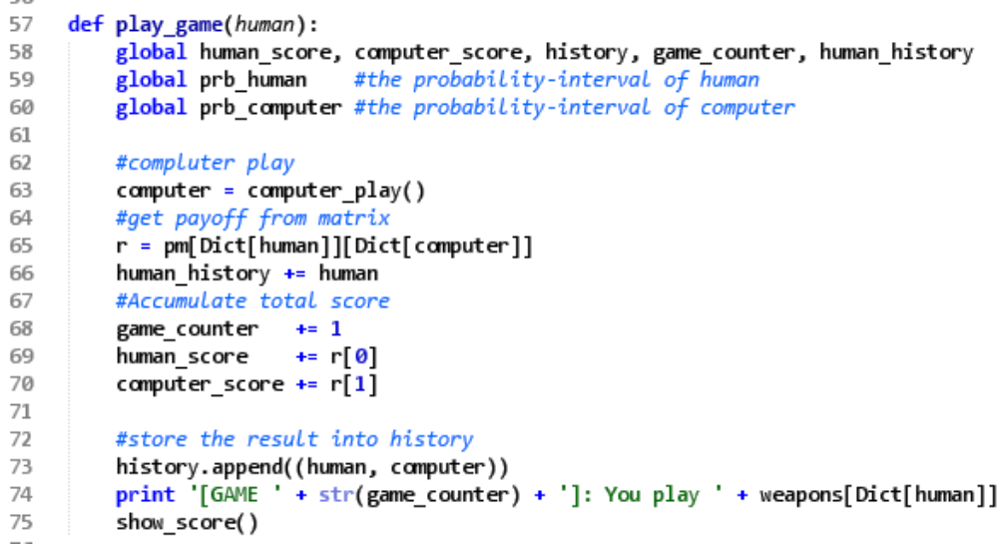
Computer’s random probability
random.random()
Returns a random floating-point number
0 < number < 1, the possible numbers are
distributed uniformly, but we can map to
non-uniformly distribution.
p1
p2
p3
1
0
p0
p4
rock
paper
scissors
lizard
Spock
For Mini-Project 1
Notes:
the random.randrange() was required by the course, so I show the usage of randrange() and show you how to using the random() function

